Slide 1

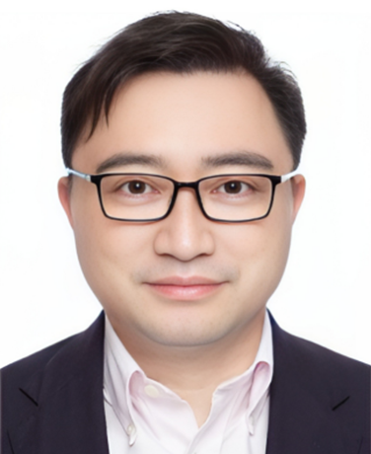




ICB 2025
The 9th International Conference on Biorefinery and Biomanufacturing
Keynote Lectures
Keynote Lectures
Min Jiang
Nanjing Tech University, China
National High-Level Personnel of Special Support Program
Prof. Min Jiang is a
Title:
Text of the abstract.....
Sao Paulo, Brazil
13-17 January 2025

