Slide 1

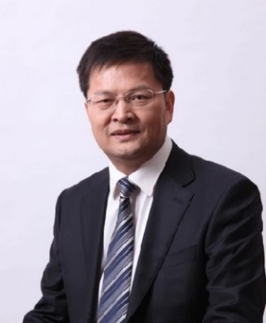




Plenary Lectures
ICB 2025
The 9th International Conference on Biorefinery and Biomanufacturing
Plenary Lectures
Plenary Lectures
Plenary Lectures
Plenary Lectures
Plenary Lectures
Tianwei Tan
Beijing University of Chemical Technology, China
Member of Chinese Academy of Engineering
Chairman of Chinese Renewable Energy Association, China
Prof. Tianwei Tan is
Title:
Text of the abstract.....
Sao Paulo, Brazil
13-17 January 2025

